Slide 1

CAP615 PROGRAMMING IN JAVA
Lecture #2

Slide 2
Today’s topics
Introduction to Java : basic java concepts:
Introduction about the java programming development tools,
Java keywords,
variables,
data types,
operators and
control statements

Slide 3
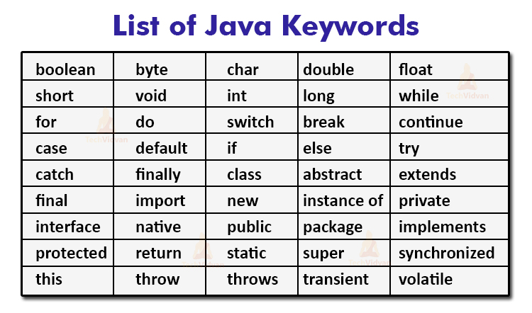
Java keywords: reserve words

Slide 4
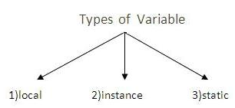
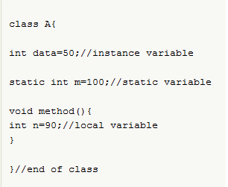
Variables:

Slide 5
Instance vs static
Instance variables gets the memory at the time of object creation, each object will have the copy of instance variable, if it is incremented, it won’t reflect to other objects.
Static variable will get the memory only once, if any object changes the value of the static variable , it will retain its value.

Slide 6
Data types in Java
Primitive
Non primitive
boolean
byte
short
int
long
char
float
double
String
Array
Class
Interface

Slide 7
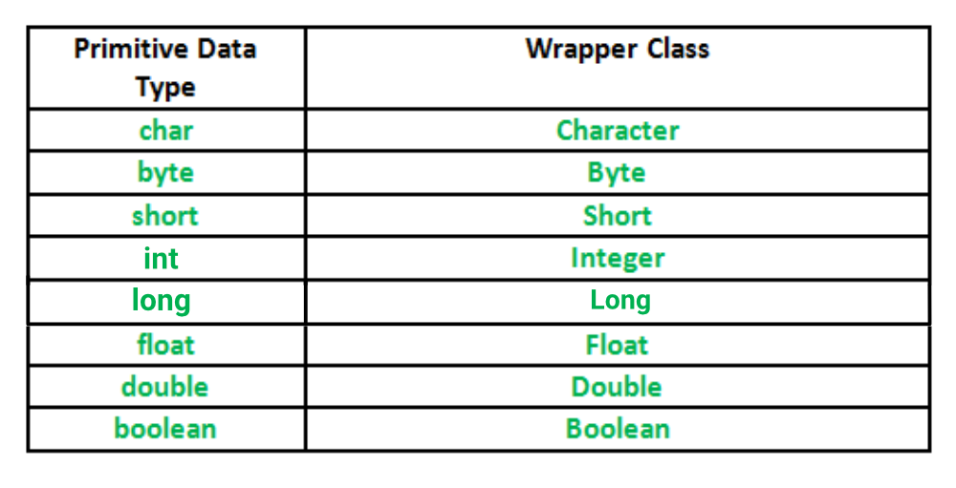
A Wrapper class is a class whose object wraps or contains
primitive data types.

Slide 8
When we create an object to a wrapper class, we can store primitive data types.
Example:
char ch = 'a';
Character a = ch;
In which case we can use:
Data structures in the Collection framework, such as ArrayList and Vector, store only objects (reference types) and not primitive types.

Slide 9
Important :what is autoboxing and unboxing?
The wrapper class in Java provides the mechanism to convert primitive into object and object into primitive.
The automatic conversion of primitive into an object is known as autoboxing and vice-versa unboxing.

Slide 10
In both which one is correct and why?
float a=10.123456789
double b=10.123456789

Slide 11
Float can store 6 digit after decimal points
Double can store 15 digit after decimal points
By default decimal will store double means
If we write Pi=3.14
It will store double datatype

Slide 12
public class Main
{
public static void main(String[] args)
{
float a=10.123456789f;
double b=10.123456789;
System.out.println(a);
System.out.println(b);
}
}

Slide 13

Operators

Slide 14
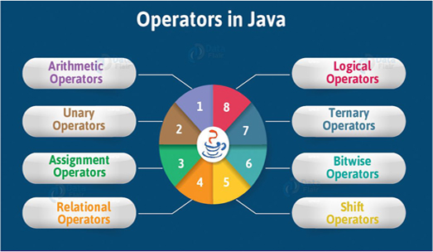

Slide 15
Arithmetic operators
Operator | Name | Example
+ | Addition | x + y
- | Subtraction | x - y
* | Multiplication | x * y
/ | Division | x / y
% | Modulus | x % y

Slide 16
Assignment Operators
Operator | Example | Same As
= | x = 5 | x = 5
+= | x += 3 | x = x + 3
-= | x -= 3 | x = x - 3
*= | x *= 3 | x = x * 3
/= | x /= 3 | x = x / 3
%= | x %= 3 | x = x % 3
&= | x &= 3 | x = x & 3
|= | x |= 3 | x = x | 3
^= | x ^= 3 | x = x ^ 3
>>= | x >>= 3 | x = x >> 3
<<= | x <<= 3 | x = x << 3

Slide 17
Comparison operators
Operator | Name | Example
== | Equal to | x == y
!= | Not equal | x != y
> | Greater than | x > y
< | Less than | x < y
>= | Greater than or equal to | x >= y
<= | Less than or equal to | x <= y

Slide 18
Logical operators
Operator | Name | Description | Example
&& | Logical and | Returns true if both statements are true | x < 5 && x < 10
|| | Logical or | Returns true if one of the statements is true | x < 5 || x < 4
! | Logical not | Reverse the result, returns false if the result is true | !(x < 5 && x < 10)

Slide 19
Unary Operators in Java
Java unary operators are the types that need only one operand to perform any operation like increment, decrement, negation, etc. It consists of various arithmetic, logical and other operators that operate on a single operand.

Slide 20


